Slide 1
GIT VCS

Slide 2
What is GIT.
Git is an open-source distributed version control system. It is designed to handle minor to major projects with high speed and efficiency. It is developed to co-ordinate the work among the developers. The version control allows us to track and work together with our team members at the same workspace.
Git was created by Linus Torvalds in 2005 to develop Linux Kernel. It is also used as an important distributed version-control tool for the DevOps.

Slide 3
Features of GIT
Open Source
Scalable
Distributed
One of Git's great features is that it is distributed. Distributed means that instead of switching the project to another machine, we can create a "clone" of the entire repository.
Security
Speed
Git is very fast, so it can complete all the tasks in a while.

Slide 4
Benefits of GIT.
Saves Time
Git is lightning fast technology. Each command takes only a few seconds to execute so we can save a lot of time as compared to login to a GitHub account.
Offline Working
One of the most important benefits of Git is that it supports offline working. If we are facing internet connectivity issues, it will not affect our work. In Git, we can do almost everything locally.
Undo Mistakes
One additional benefit of Git is we can Undo mistakes.
Track the Changes
Git facilitates with some exciting features such as Diff, Log, and Status, which allows us to track changes so we can check the status, compare our files or branches.

Slide 5
What is GitHub.
GitHub is a Git repository hosting service.
It offers both distributed version control and source code management (SCM) functionality of Git.

Slide 6
What is GIT Version control system.
A version control system is a software that tracks changes to a file or set of files over time so that you can recall specific versions later. It also allows you to work together with other programmers.
The version control system is a collection of software tools that help a team to manage changes in a source code. It uses a special kind of database to keep track of every modification to the code.
Developers can compare earlier versions of the code with an older version to fix the mistakes.

Slide 7
Benefits of the Version Control System
Complete change history of the file
Simultaneously working
Branching and merging
Traceability

Slide 8
Types of version control system.
Localized version Control System
Centralized version control systems
Distributed version control systems

Slide 9
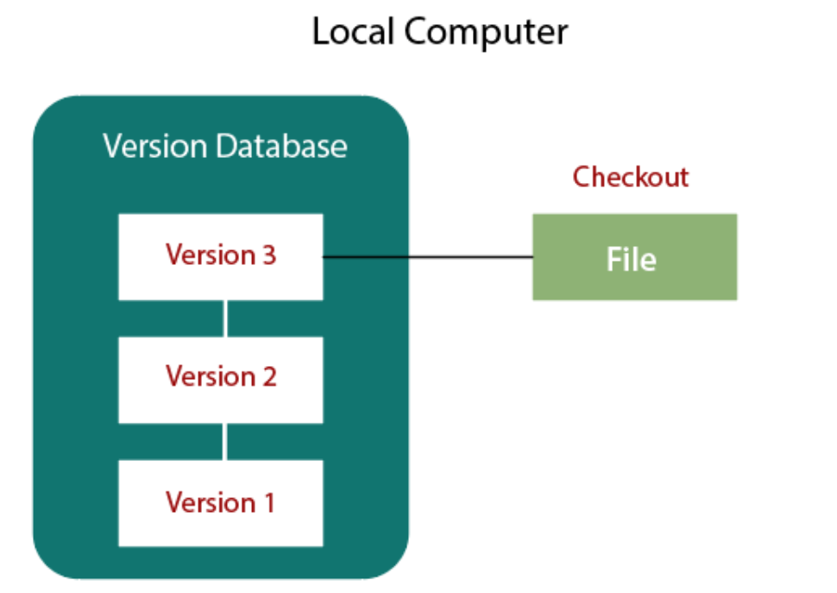
Localized Version Control Systems
The localized version control method is a common approach because of its simplicity. But this approach leads to a higher chance of error. Also cant integrate other programmers changes in the system.

Slide 10
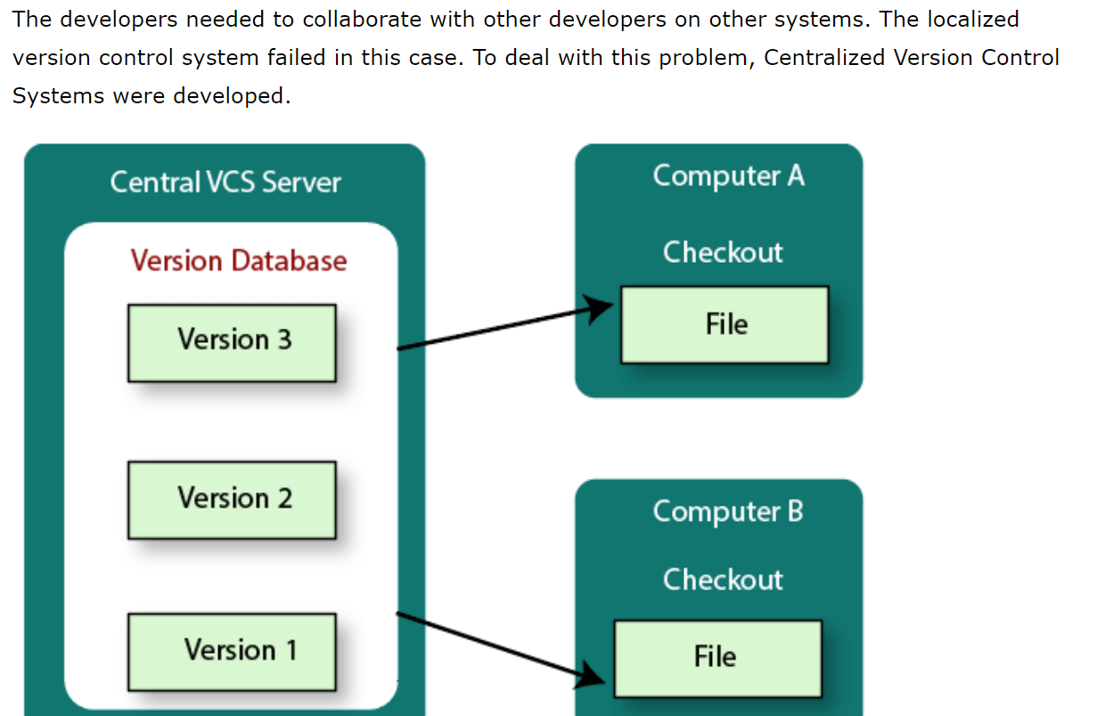
Centralized Version Control System

Slide 11
Distributed Version Control System
Centralized Version Control System uses a central server to store all the database and team collaboration. But due to single point failure, which means the failure of the central server, developers do not prefer it. Next, the Distributed Version Control System is developed.
In a Distributed Version Control System (such as Git, Mercurial, Bazaar or Darcs), the user has a local copy of a repository. The local repository contains all the files and metadata present in the main repository.

Slide 12
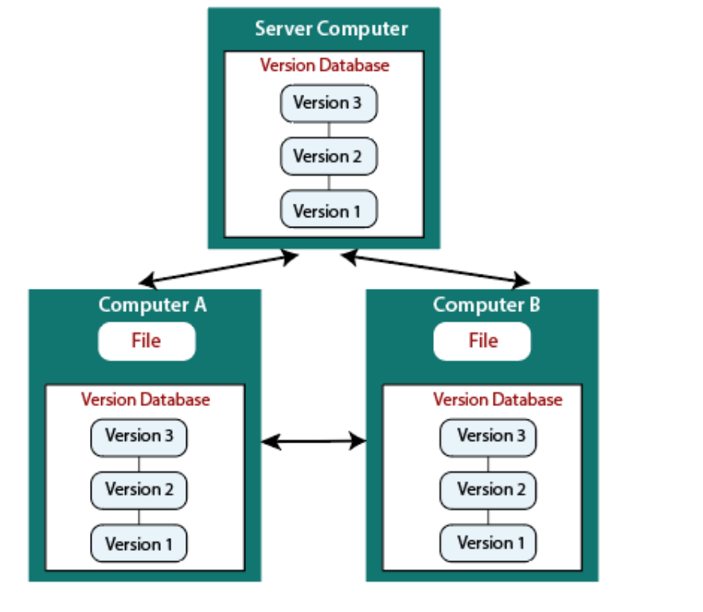
Distributed Version Control System

Slide 13
Install git.
Install git from the following location.
https://git-scm.com/downloads.

Slide 14
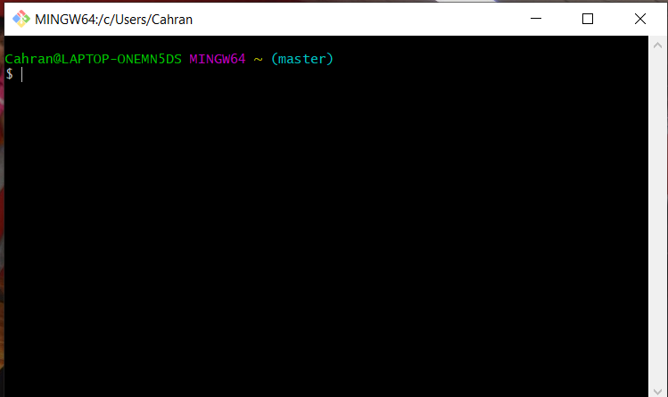
Git
After the installation, open the application and it opens given below:

Slide 15
Setting the environment.
Setting user.name and user.email are the necessary configuration options as your name and email will show up in your commit messages.
$ git config --global user.name "Charan Kumar"
$ git config --global user.email "kcharankumar@gmail.com"

Slide 16
Git commands.
The git init command is the first command that you will run on Git. The git init command is used to create a new blank repository. It is used to make an existing project as a Git project.
$ Git init
Create a new file and add it to the repository and commit it and push it to master.

Slide 17
Add files and commit.
Create file by name my_first_file.txt from explorer.
$git add “my_first_file.txt”
$git commit –m “This is the first file to commit”

Slide 18
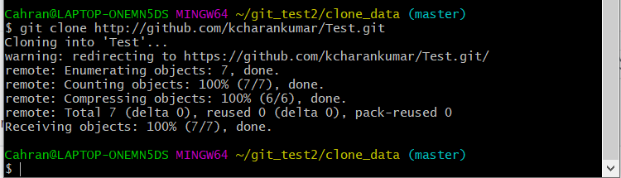
Cloning
We can clone hithub repository as a local copy.
Go to github.com, place few files. Commit the changes.
Click on code under repository. Select the URL.
In the command line of gitbash create a new directory, move to that directory and then give the following command
$git clone <URL from the github>
All the files are cloned from github to local git.

Slide 19
GIT Repository.
A quick recap, In Git, the repository is like a data structure used by VCS to store metadata for a set of files and directories. It contains the collection of the files as well as the history of changes made to those files.
There are two ways to obtain a repository. They are as follows:
Create a local repository and make it as Git repository.
Clone a remote repository (already exists on a server).

Slide 20
Repository.
Local repository
$git init
$git add “file”
$git commit –m “Comments”
Clong a remote repository.
$git clone “Repository URL”

Slide 21
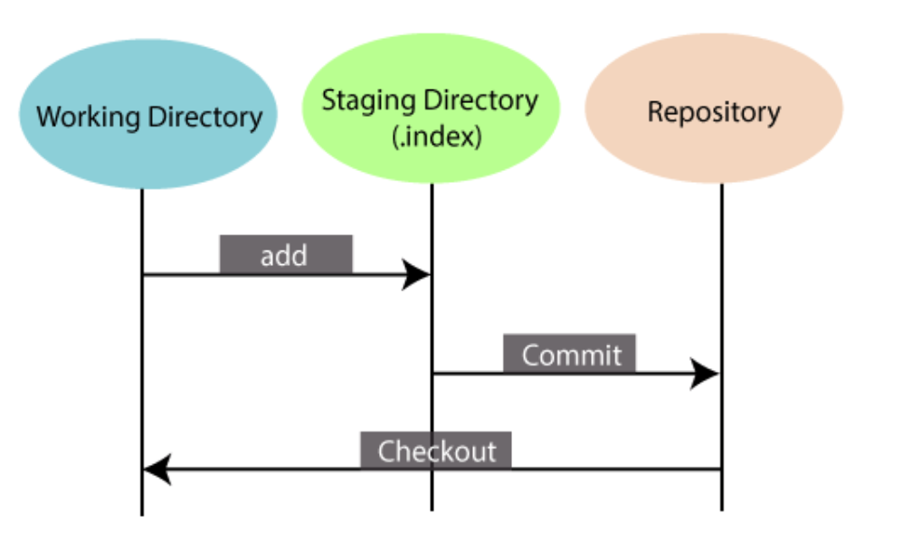
GIT Index.
Working Directory: When you worked on your project and made some changes, you are dealing with your project's working directory.
Staging Area : The staging area can be described as a preview of your next commit. When you create a git commit, Git takes changes that are in the staging area and make them as a new commit.
Repository : In Git, Repository is like a data structure used by GIt to store metadata for a set of files and directories. It contains the collection of the files as well as the history of changes made to those files.
Index is the one which stores information about the file like Time of last update, name of the file, version of the file.

Slide 22
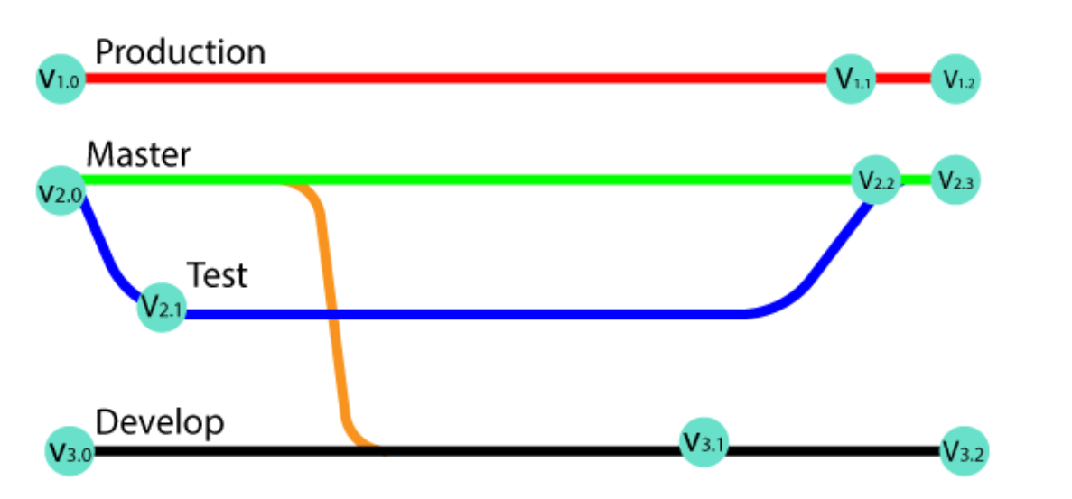
GIT Tag
Tags make a point as a specific point in Git history. Tags are used to mark a commit stage as relevant. We can tag a commit for future reference. Primarily, it is used to mark a project's initial point like v1.1.
Tags are much like branches, and they do not change once initiated. We can have any number of tags on a branch or different branches. The below figure demonstrates the tags on various branches.

Slide 23
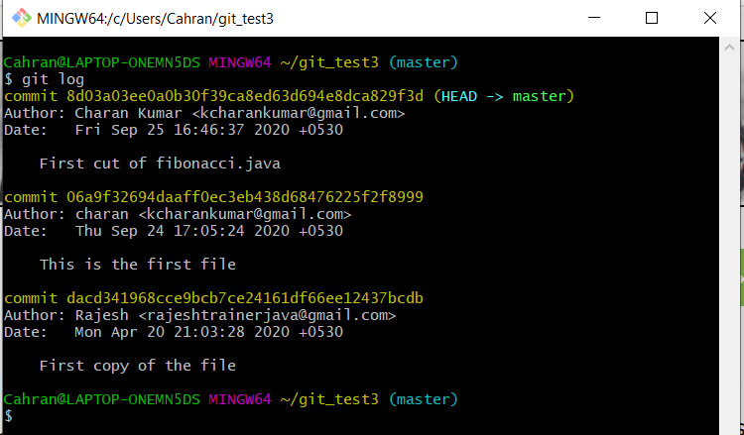
Git log
Git log is a utility tool to review and read a history of everything that happens to a repository.
Generally, the git log is a record of commits.

Slide 24
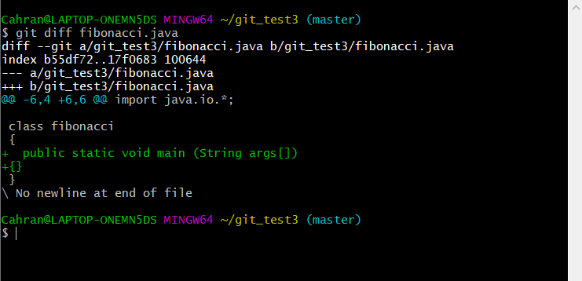
Git diff.
Diff will specify the difference of changes done from repository to the local copy.
For this create a file, add a file to the staging area and commit it repository and then modify the working copy of the same file and give the git diff command.
$git diff fibonacci.java

Slide 25
Git status
The git status command is used to display the state of the repository and staging area. It allows us to see the tracked, untracked files and changes. This command will not show any commit records or information.
Mostly, it is used to display the state between Git Add and Git commit command. We can check whether the changes and files are tracked or not.

Slide 26
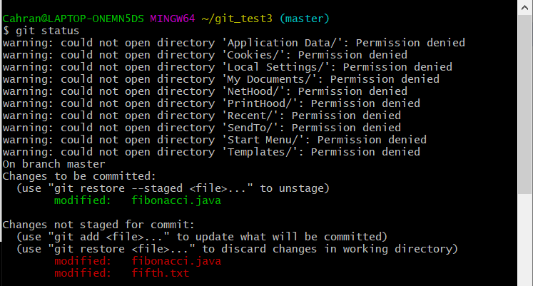
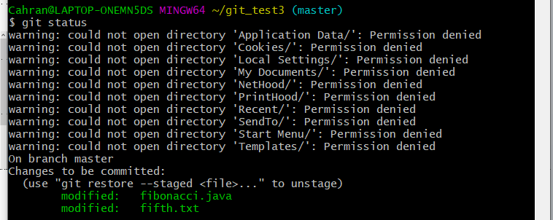
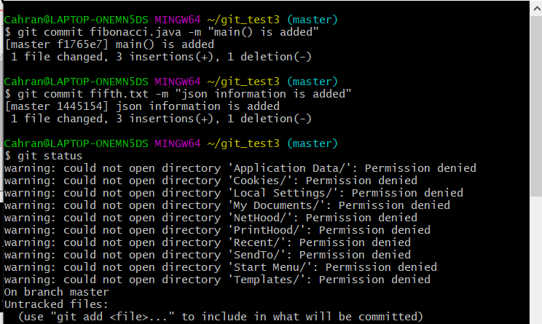
Git status
Here the files are modified in the local copy but not staged and committed.
After adding these files in the staging area, git status is specifying these two files are not committed in the repository.
After committing the changes, status shows that there are no modified or to be committed.

Slide 27
Git mv
Git mv is used to rename a file.
Create a file as OldFile.txt and commit it.
$git mv –f OldFile.txt NewFile.txt
Check whether the file name is modified or not. Open the content of the file and verify it.

Slide 28
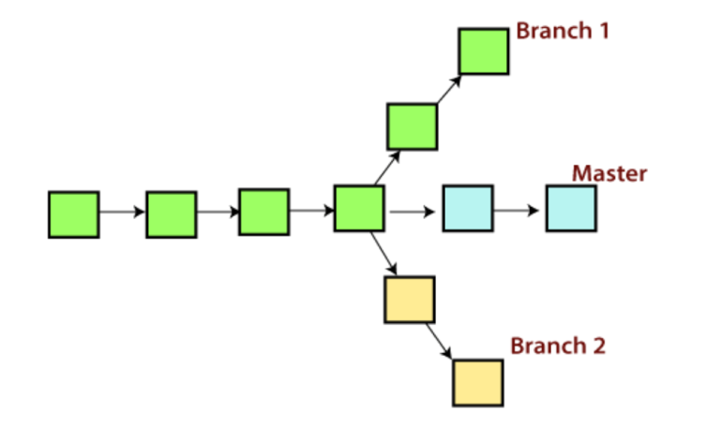
GIT Branching
A branch is a version of the repository that diverges from the main working project. It is a feature available in most modern version control systems. A Git project can have more than one branch. These branches are a pointer to a snapshot of your changes. When you want to add a new feature or fix a bug, you spawn a new branch to summarize your changes. So, it is complex to merge the unstable code with the main code base and also facilitates you to clean up your future history before merging with the main branch.

Slide 29
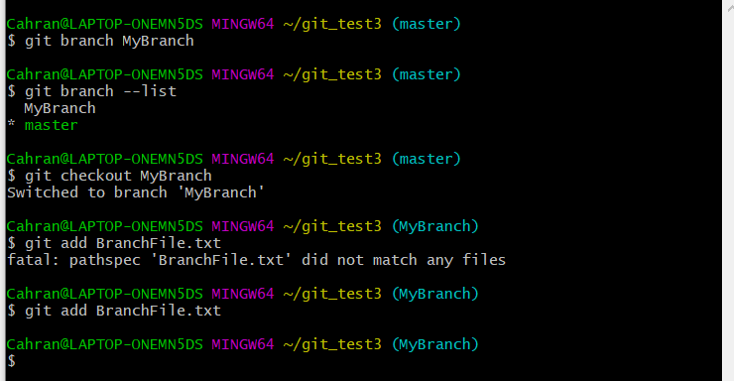
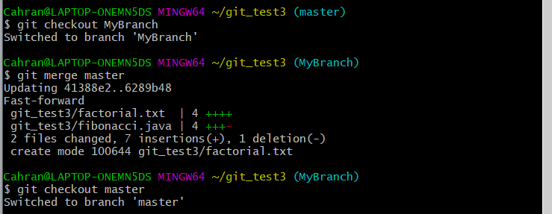
GIT Branch
Git checkout
switches from branch to branch. A new file is added in the branch.
Create a file in master and create a branch. Switch to that branch. Merge from master to newly created branch.
Git merge merges from one branch to another branch.
After modifying the file in the branch, it has to be staged by git add and commit it and merge it in the master branch.

Slide 30
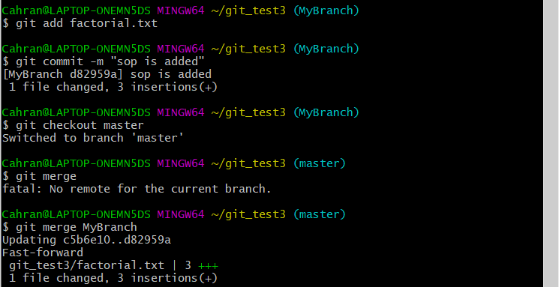
Git merge

Slide 31
Git ignore
Create a .gitignore file
$touch .gitignore
in gitignore file, add MyFile.txt
Add .gitignore file and commit it.
Even if MyFile.txt is there in the directory, it will not show in git status to add the file. When this file to be added in the staging area, it says this file is in the ignored list.

Slide 32
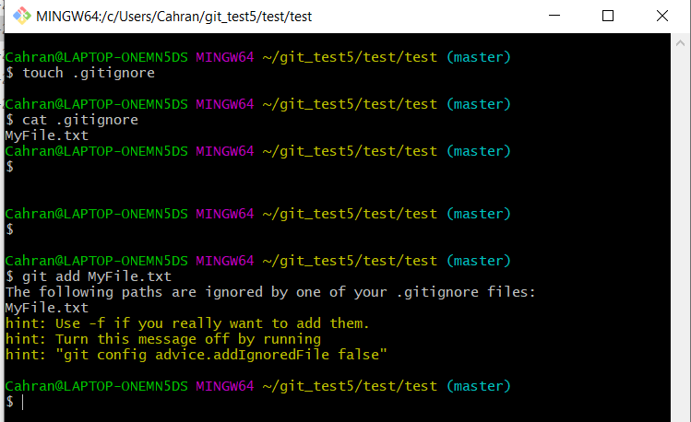
Git ignore
If the file is added then it will push into the github.

Slide 33
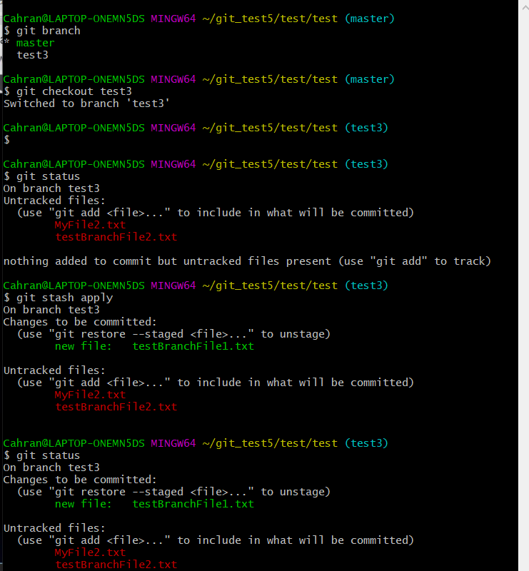
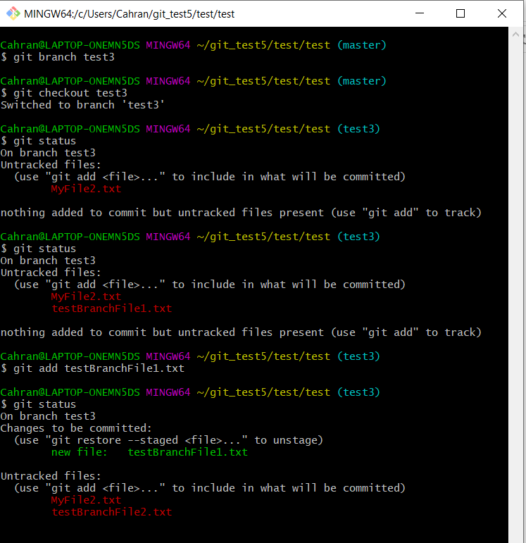
Git stash

Slide 34
Git stash
After the changes are in staging area in a branch and if you want to switch to another branch without commiting the changes. Then you can save the current state and then come back later and can revert from stash by using stash apply.
Created a branch test, two files are created. One file is added to staging area. Applied git stash on it. Switch to another branch using git checkout. Come back to same branch. Apply git stash and check which files are in staging area and which files are not.

Slide 35
Git head.
The HEAD points out the last commit in the current checkout branch. It is like a pointer to any reference. The HEAD can be understood as the "current branch." When you switch branches with 'checkout,' the HEAD is transferred to the new branch.

Slide 36
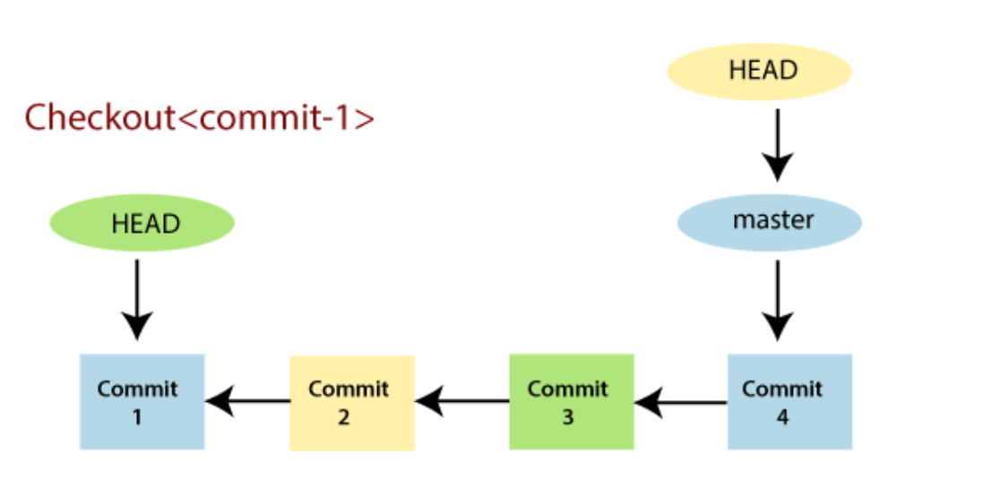
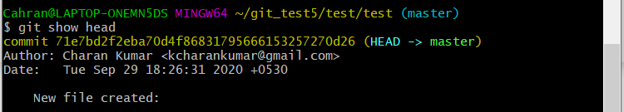
Git head
The above fig shows the HEAD referencing commit-1 because of a 'checkout' was done at commit-1. When you make a new commit, it shifts to the newer commit.

Slide 37
Git show head
Git show head shows the head location of the committed file. You can also see the same in git log.

Slide 38
Git remote
https://docs.github.com/en/get-started/getting-started-with-git/managing-remote-repositories --> For git remote add.
$git remote –v
Shows the remote server location.
$git remote rm origin
This will remove the origin or you can specify the remote server added.
$git remote add origin https://github.com/kcharankumar/Test.git
This will add the remote server. RemoteSer is the name given to the remote server.
$git remote –v
Create a new file in github.
$git pull origin master
This file is pulled into the local repository.
$git remote rm RemoteSer → This removes the RemoteSer connection with the remote server.
$git remote –v
If git push and pull is not working, first clone it with the remote git as
$git clone https://github.com/kcharankumar/Test.git --> This will get the files from remote repository to the local repository.

Slide 39
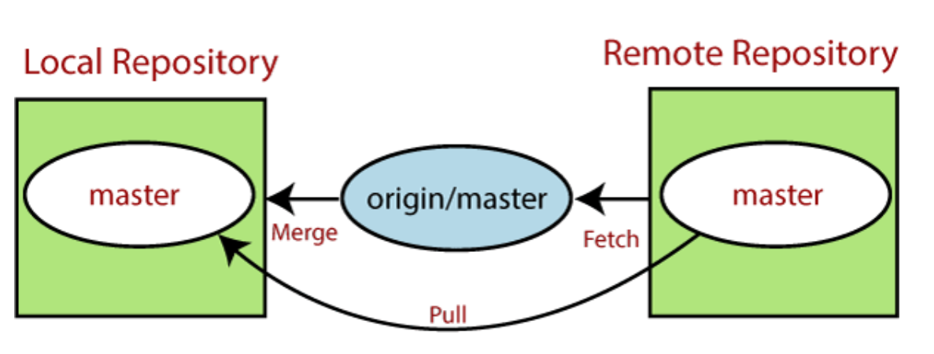
Git pull
Git pull pulls the data from the remote repository to the local repository.

Slide 40
Git revert
Git revert will reverts the previous commit.
Create a file and commit it.
Make the changes to the same file and commit it again.
Check the log and get the head id.
$git revert <head id from log file>
This will prompt a message to edit for removing the committed changes.
Cat file name.

Slide 41
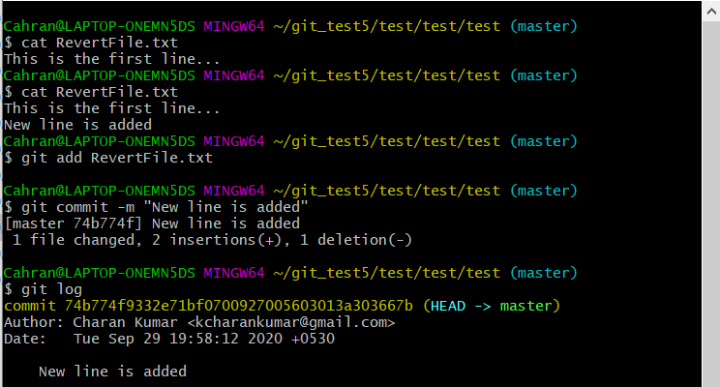
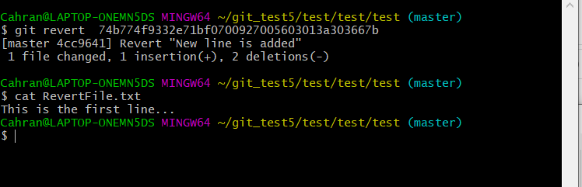
Git revert

Slide 42
Git tag
Create 3 files named file1, file2, file3.
Add some content into it.
Commit the changes.
Create a tag for version1.0 for these files as
$git tag version1.0
$git tag → Shows all the tags.
$git show version1.0 → Displays the files of version1.0
Modify these files file1, file2 and file3.
Commit the changes.
Create another tag version2.0 as
$git tag version2.0
$git tag
$git show version2.0
$git checkout version2.0 → See the file content of version2.0
$git checkout version1.0 → See the file content of version1.0
$git tag -d <tag name> → Removes that tag.

Slide 43
Thank you

